Slide 1
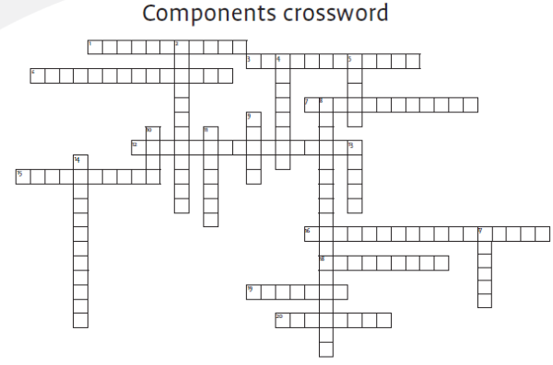

Slide 2
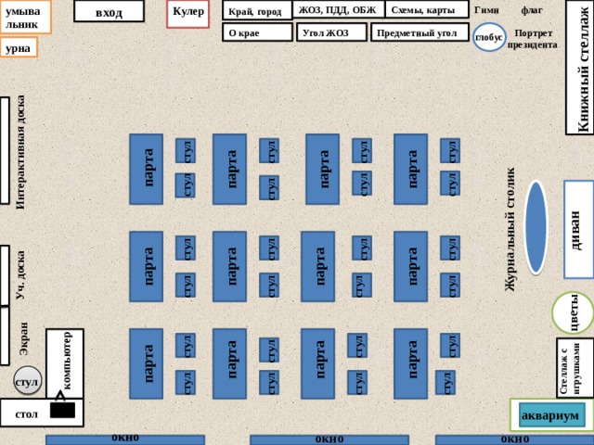
5 пакет
4 задание
1 пакет
6 пакет
2 пакет
3 пакет

Slide 3
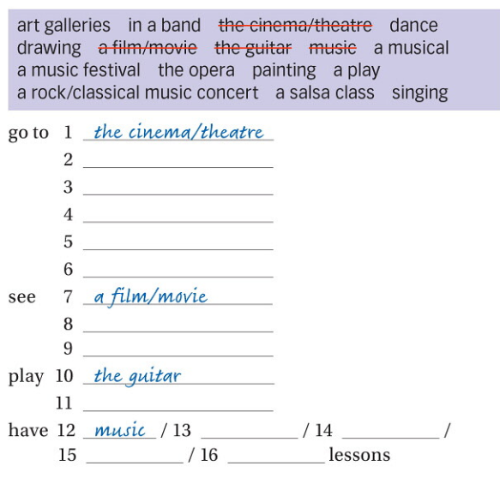
Never
1 time
2 times
Many times
A few times
Art galleries
Music concert
A music festival
The opera
concert
play
A musical
In a band
painting
A salsa class
singing
drawing

Slide 4
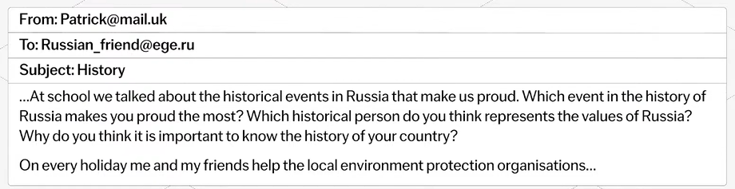


Slide 5
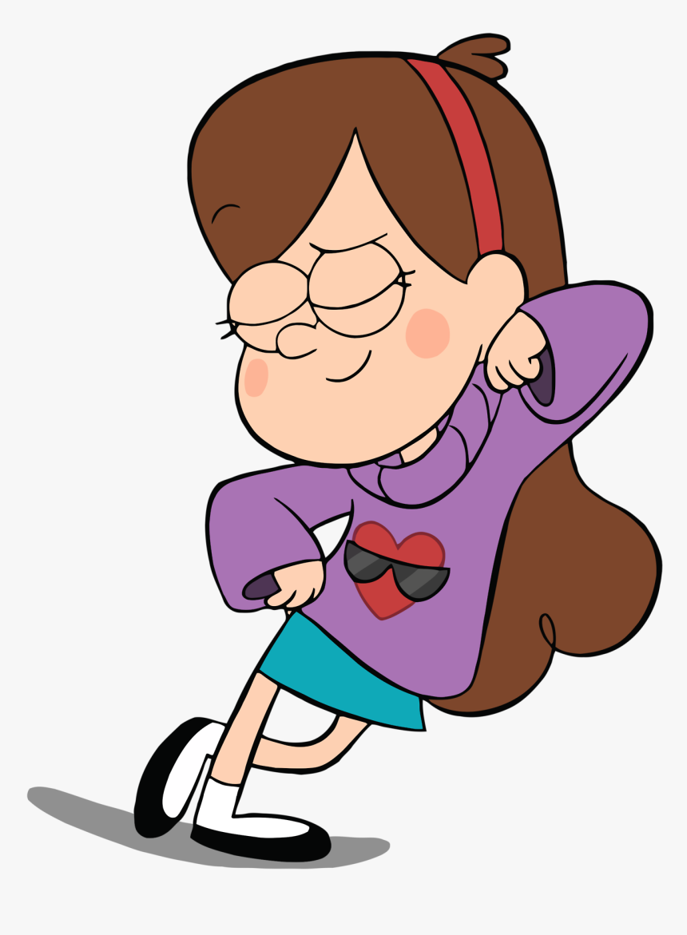
Mabel
Her name ___
She ___ years old.
She ___ (a girl/a boy) Her favourite colors ___ Her favourite animal ___
Her best friend ___
Her brother ___
Her brother ___ years old
Her uncle ___

Slide 6
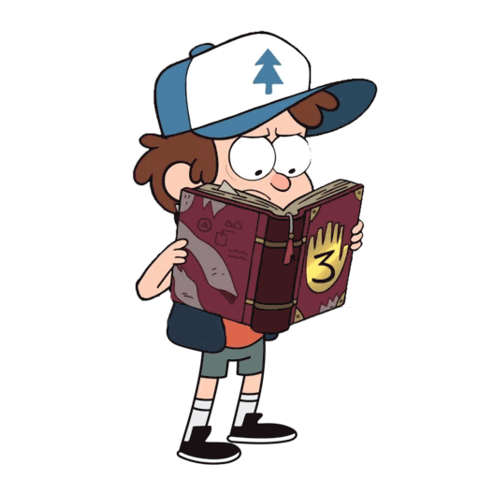
Dipper
His name ___
He ___ years old.
He ___ (a girl/a boy) His favourite colors ___ His favourite animal ___
His best friend ___
His sister ___
His sister ___ years old
His uncle ___

Slide 7
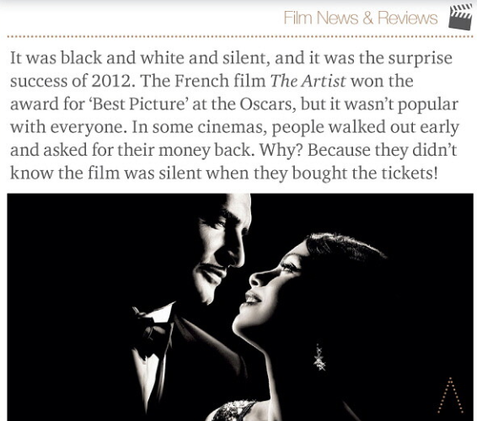
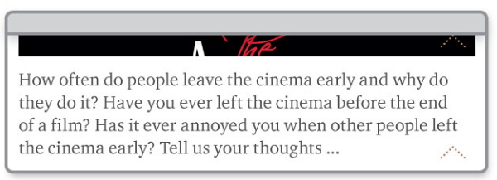

Slide 8
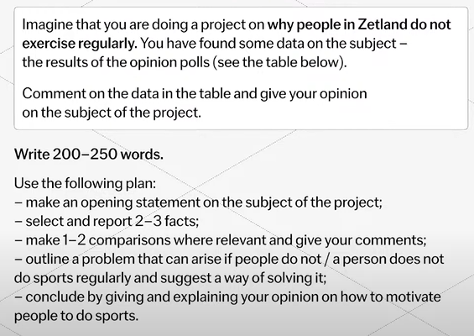
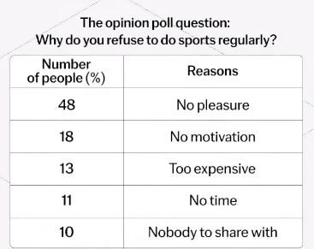

Slide 9
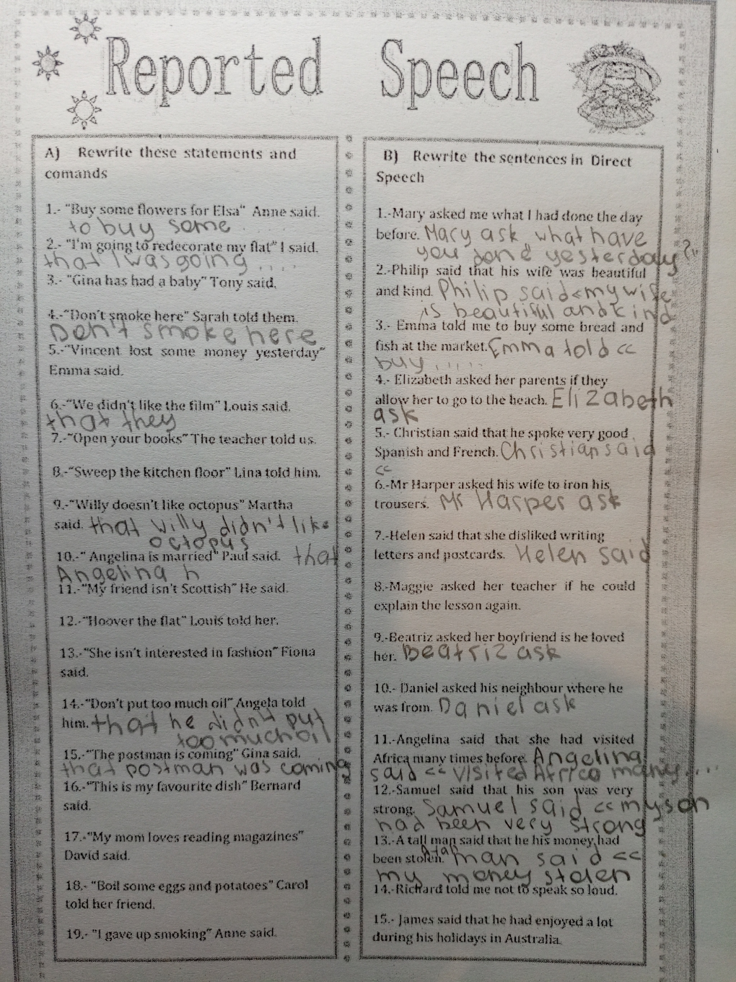
Have/has + V3
If – если/ли
This was his fav dish

Slide 10
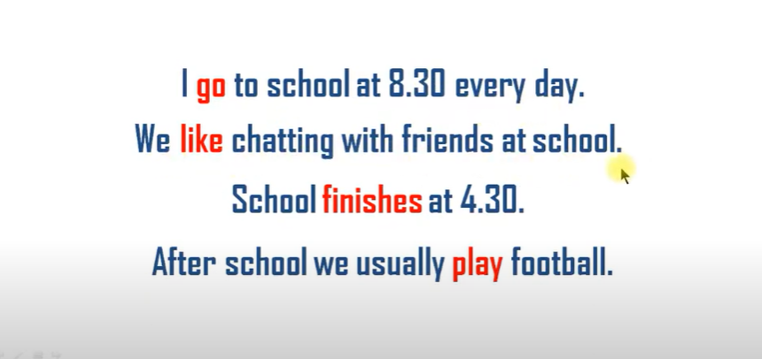

Slide 11
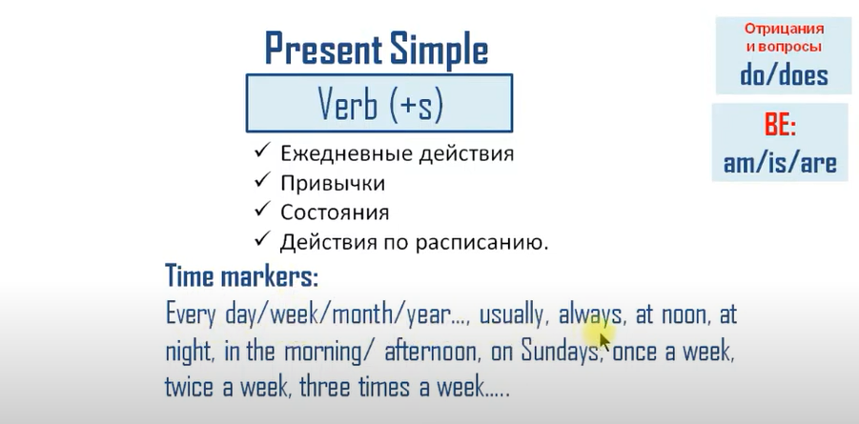

Slide 12
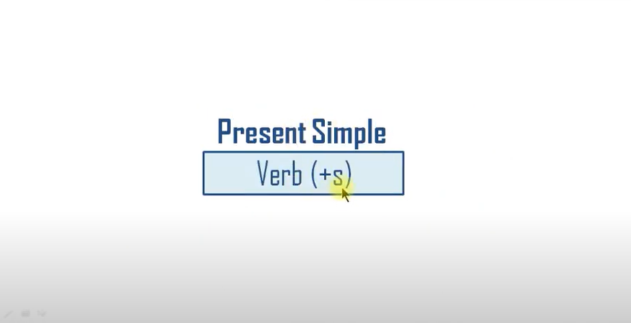

Slide 13
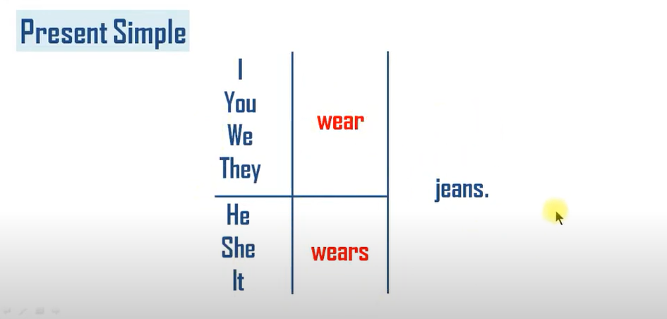

Slide 14
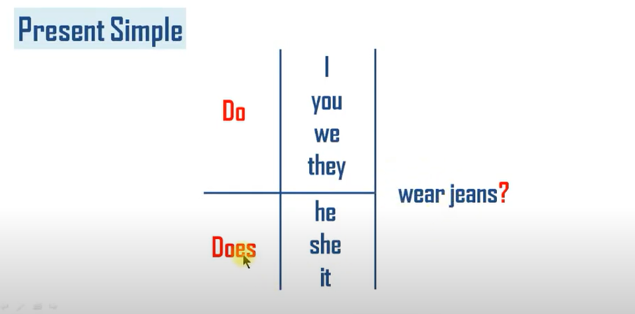

Slide 15
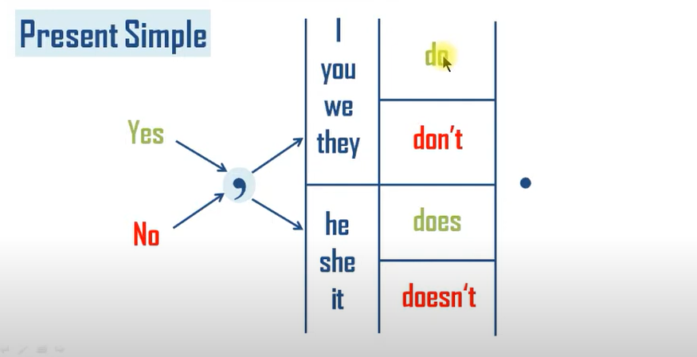

Slide 16
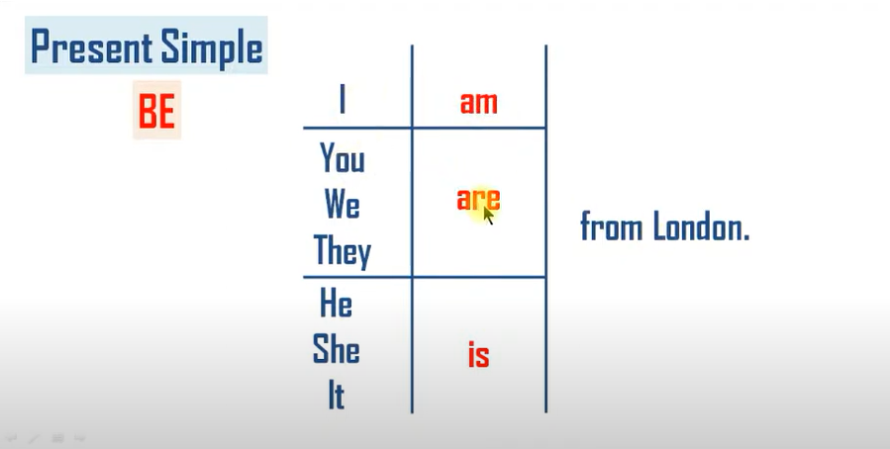

Slide 17
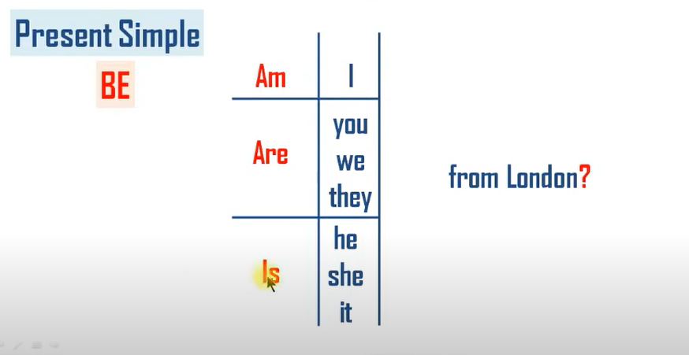

Slide 18
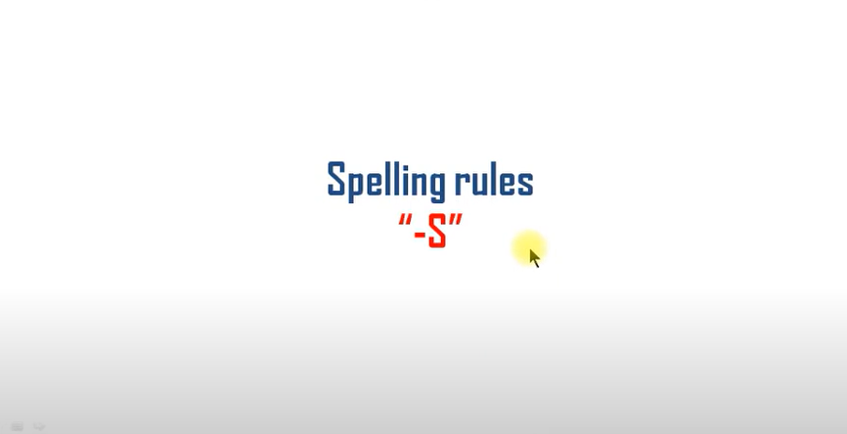

Slide 19
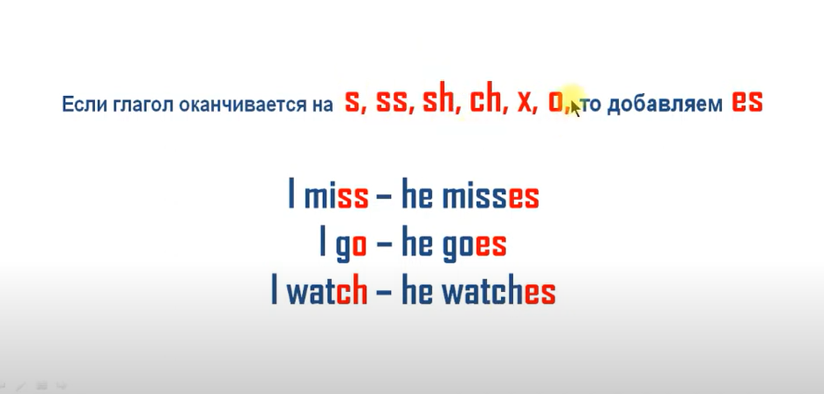

Slide 20
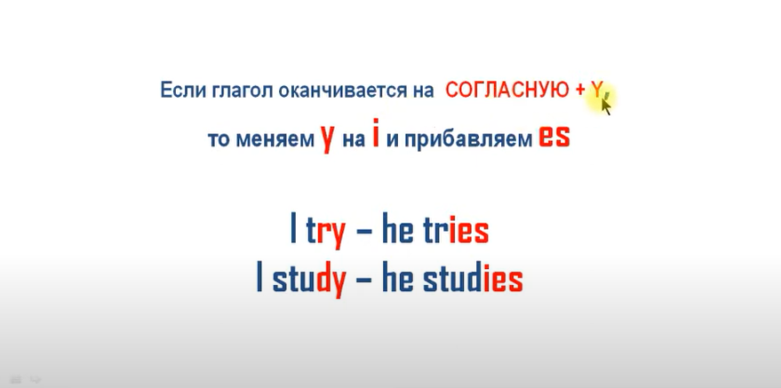

Slide 21
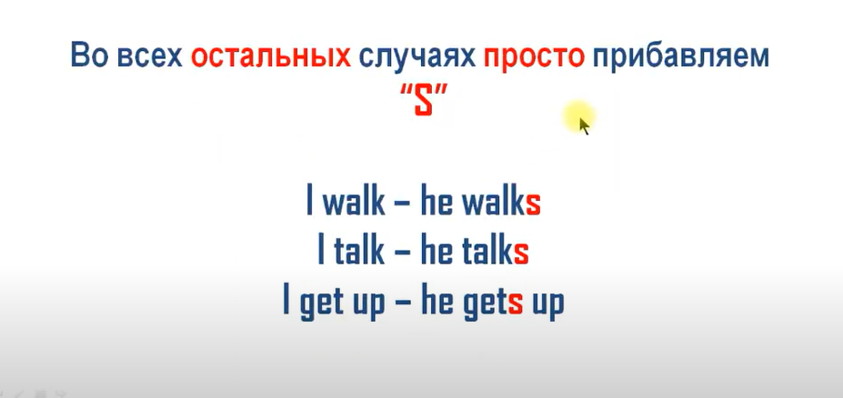

Slide 22
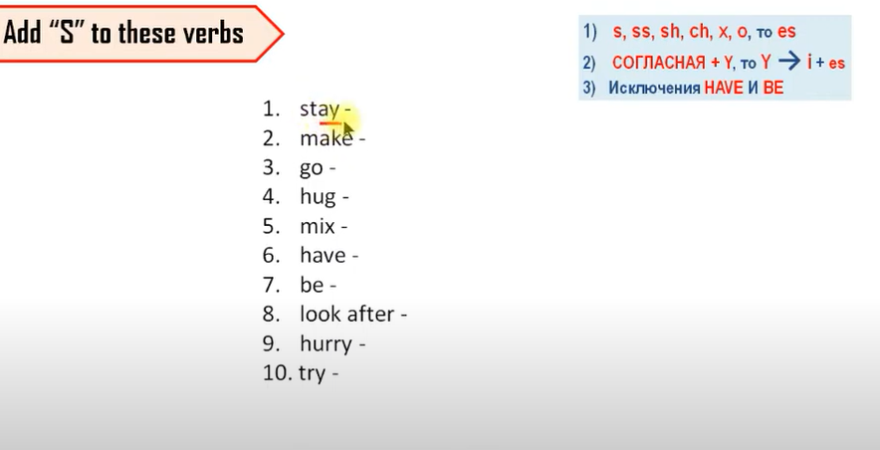

Slide 23
